Slide 1
Quiz Game Project
Name: Pembarthi Tulasi
Project

Slide 2
Introduction to the Quiz Game Project
This project aims to create an engaging and educational quiz game.
The game will cater to various topics and difficulty levels for diverse audiences.
Our goal is to enhance learning through interactive gameplay and competition.
Notes:
Image source: https://www.slidemake.com

Slide 3
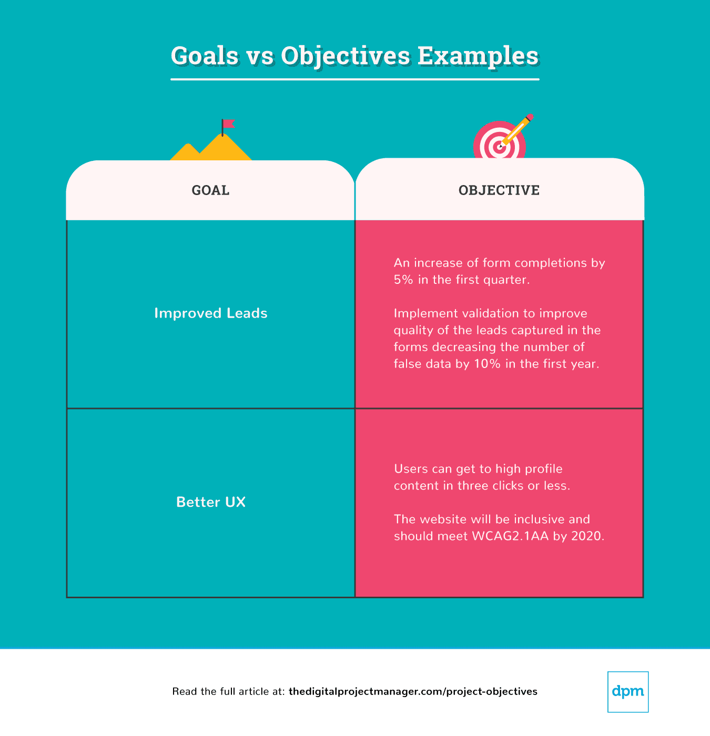
Objectives of the Project
The primary objective is to develop an entertaining platform for knowledge testing.
We aim to promote collaboration and friendly competition among players.
The project will also seek to gather user feedback for continuous improvement.
Notes:
Image source: https://thedigitalprojectmanager.com

Slide 4
Target Audience
Our quiz game is designed for students, educators, and trivia enthusiasts.
It will be suitable for various age groups, from children to adults.
We aim to attract users interested in learning new subjects through gameplay.
Notes:
Image source: https://www.slidemake.com

Slide 5
Game Features
The game will include multiple-choice questions with varying difficulties.
Users will have the option to play solo or compete in multiplayer mode.
Leaderboards and rewards will encourage repeated play and engagement.
Notes:
Image source: https://www.researchgate.net

Slide 6
Technology Stack
The quiz game will be developed using HTML, CSS, and JavaScript.
A backend server will be implemented using Node.js for data management.
We will utilize a database such as MongoDB to store user data and questions.
Notes:
Image source: https://www.slidemake.com

Slide 7
Question Database
The quiz will feature a diverse question database across various subjects.
Questions will be categorized by difficulty to cater to all player skill levels.
Regular updates will ensure the content remains current and engaging.
Notes:
Image source: https://www.slidemake.com

Slide 8
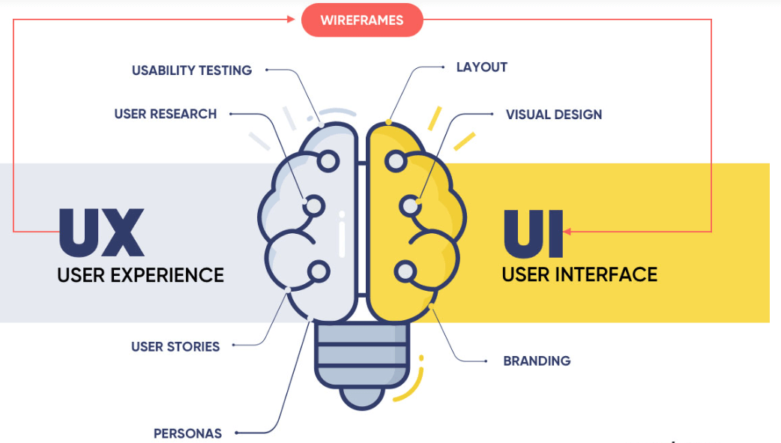
User Experience Design
Our design will focus on a user-friendly interface that is easy to navigate.
We will implement responsive design to ensure compatibility across devices.
Engaging visuals and sound effects will enhance the overall gaming experience.
Notes:
Image source: https://squibble.ams3.cdn.digitaloceanspaces.com

Slide 9
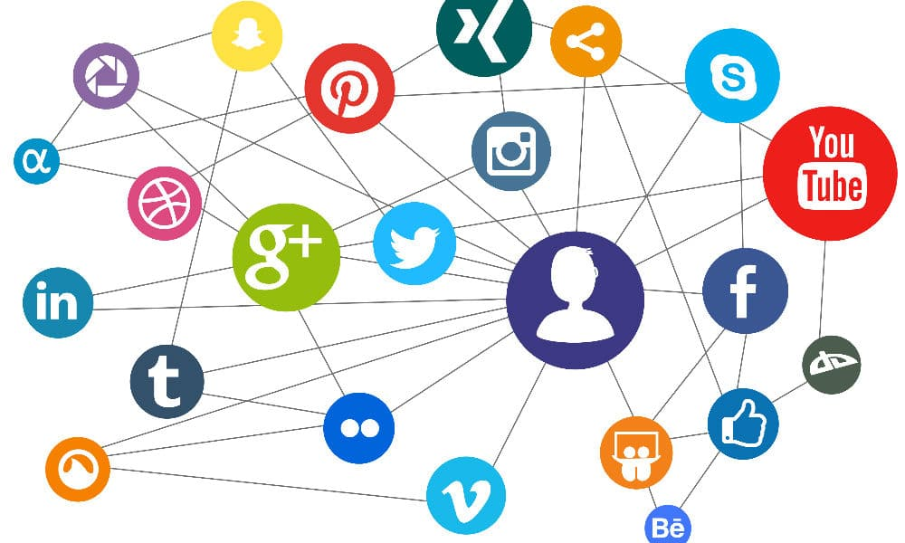
Marketing Strategy
We plan to utilize social media platforms for promoting the quiz game.
Collaborations with educational institutions will help reach our target audience.
User-generated content and challenges will encourage organic growth and engagement.
Notes:
Image source: https://www.imaginarylava.org

Slide 10
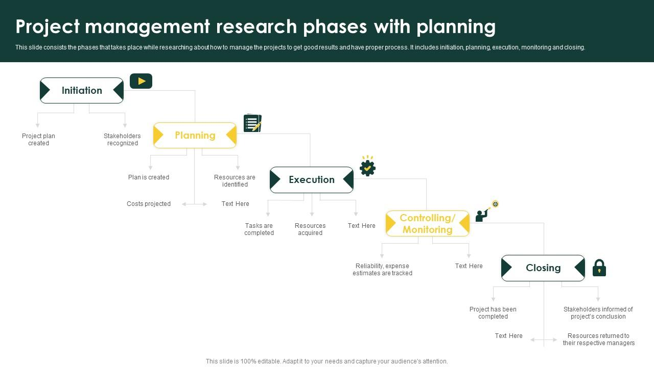
Development Timeline
The project will be divided into phases, starting with research and planning.
Development will take approximately three months, followed by testing.
We aim for a soft launch to gather initial user feedback before a full release.
Notes:
Image source: https://www.slideteam.net

Slide 11
Conclusion and Future Plans
The quiz game project aims to blend education with entertainment effectively.
Future updates may include additional features such as user-created quizzes.
We envision expanding the game into different platforms and languages for broader reach.
Notes:
Image source: https://www.slidemake.com

